Slide 1

Improving
Neural Networks

Slide 2
Network Weights Initialization
Activation Functions
Dropout
Batch Normalization
Learning Rate
Optimizers

Slide 3
Deep Neural Network
Hidden Layers
Input
Output
Multiple Hidden Layers

Slide 4
Deep Neural Network
Hidden Layers
Input
Output
Fully Connected Neural Network
All outputs of in a hidden layer are connected to next layer

Slide 5
Deep Neural Network
Hidden Layers
Input
Output
… also called Multi-Layer Perceptron (MLP)

Slide 6

What does improving Neural Networks mean?
Reducing Loss or Improving Accuracy

Slide 7
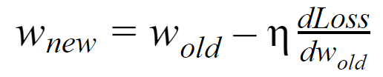
We use this equation to reduce loss

Slide 8

Usually it’s not pretty
Where should we start?

Slide 9
Hidden Layer
Input
Output
What should be initial weights?

Slide 10

What can be possible issue?
Each Neuron in a layer should be initialized with different Weights

Slide 11

Pick Random Numbers

Slide 12
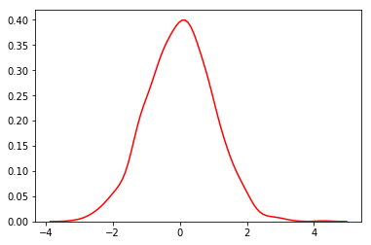
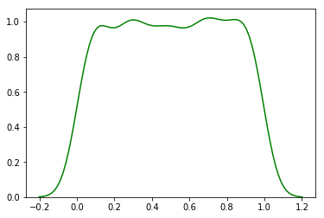
Normal Distribution
Uniform Distribution
We can pick random numbers from either Normal or Uniform Distribution

Slide 13
What could go wrong with Weights initialization using Random numbers

Slide 14


Vanishing Gradient
Gradient becomes close to zero

Slide 15
If Weights are initialized with big numbers
Y = wx + b will a large value
Sigmoid of Y will be closer to ‘1’
Gradient of will be very small which means very slow learning or No learning at all

Slide 16

Exploding Gradient

Slide 17
h₁₁
2.1
o₁₁ = 0.89
W₁₁₁ = 0.5
Input
W₁₁₂ =0.3
h₂₁
W₂₁₁ = -0.23
Output
1
2
Loss
W₁₂₁ = 0.15
1.95
o₁₂ = 0.875
W₂₁₂ = 0.83
1.106
1.793
W₁₂₂ = 0.4
W₂₁₃ = -0.56
W₁₃₁ = 0.65
h₁₃
1.05
W₁₃₂ = -0.3
o₁₃ = 0.741
Updating weight for hidden layer e.g W₁₁₁

Slide 18
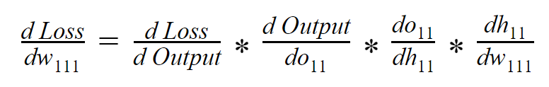
Using Chain Rule

Slide 19
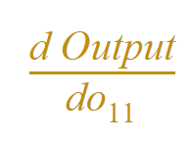

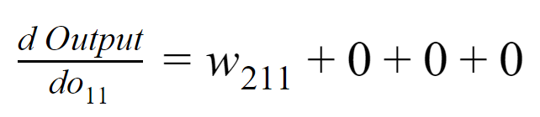
Gradient in Hidden Layer is dependent on Weights in Next Layers

Slide 20
What if W₂₁₁ is a large number
W₁₁₁ will get a large Gradient
New value of W111 may become very large ..
and may result in Overflow causing ‘NaN’ errors

Slide 21

Search for better Weights initialization

Slide 22
Xavier or Glorot Initialization
Understanding the difficulty of training deep feedforward neural networks

Slide 23
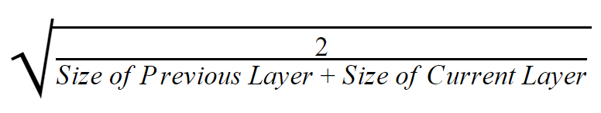
Xavier or Glorot Initialization
Normal Distribution
Initialize weights with random numbers from mean 0 and standard deviation calculated above

Slide 24
Xavier or Glorot Initialization
Uniform Distribution
6
Random numbers between -limit to + limit whereas limit is calculated using formula above.

Slide 25
he initialization
Delving Deep into Rectifiers: Surpassing Human-Level Performance on ImageNet Classification

Slide 26
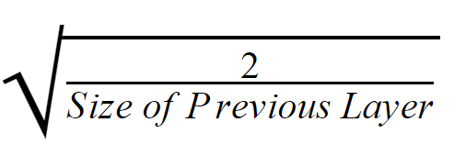
he initialization
Normal Distribution
Initialize weights with random numbers from mean 0 and standard deviation calculated above

Slide 27
he initialization
Uniform Distribution
6
Random numbers between -limit to + limit whereas limit is calculated using formula above.

Slide 28

Review different initializers in Keras

Slide 29
Which approach to prefer?
Use he initialization when using ReLu

